Slide 1

The Fifth Element
Azure Secure Devops
Mike Martin – Cloud Solution Architect
Microsoft

Slide 2
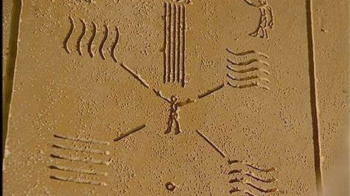
“… in their possession are the four elements of life.
These elements when they are gathered around a fifth:
The Supreme Being, ultimate warrior, created to PROTECT LIFE......”

Slide 3
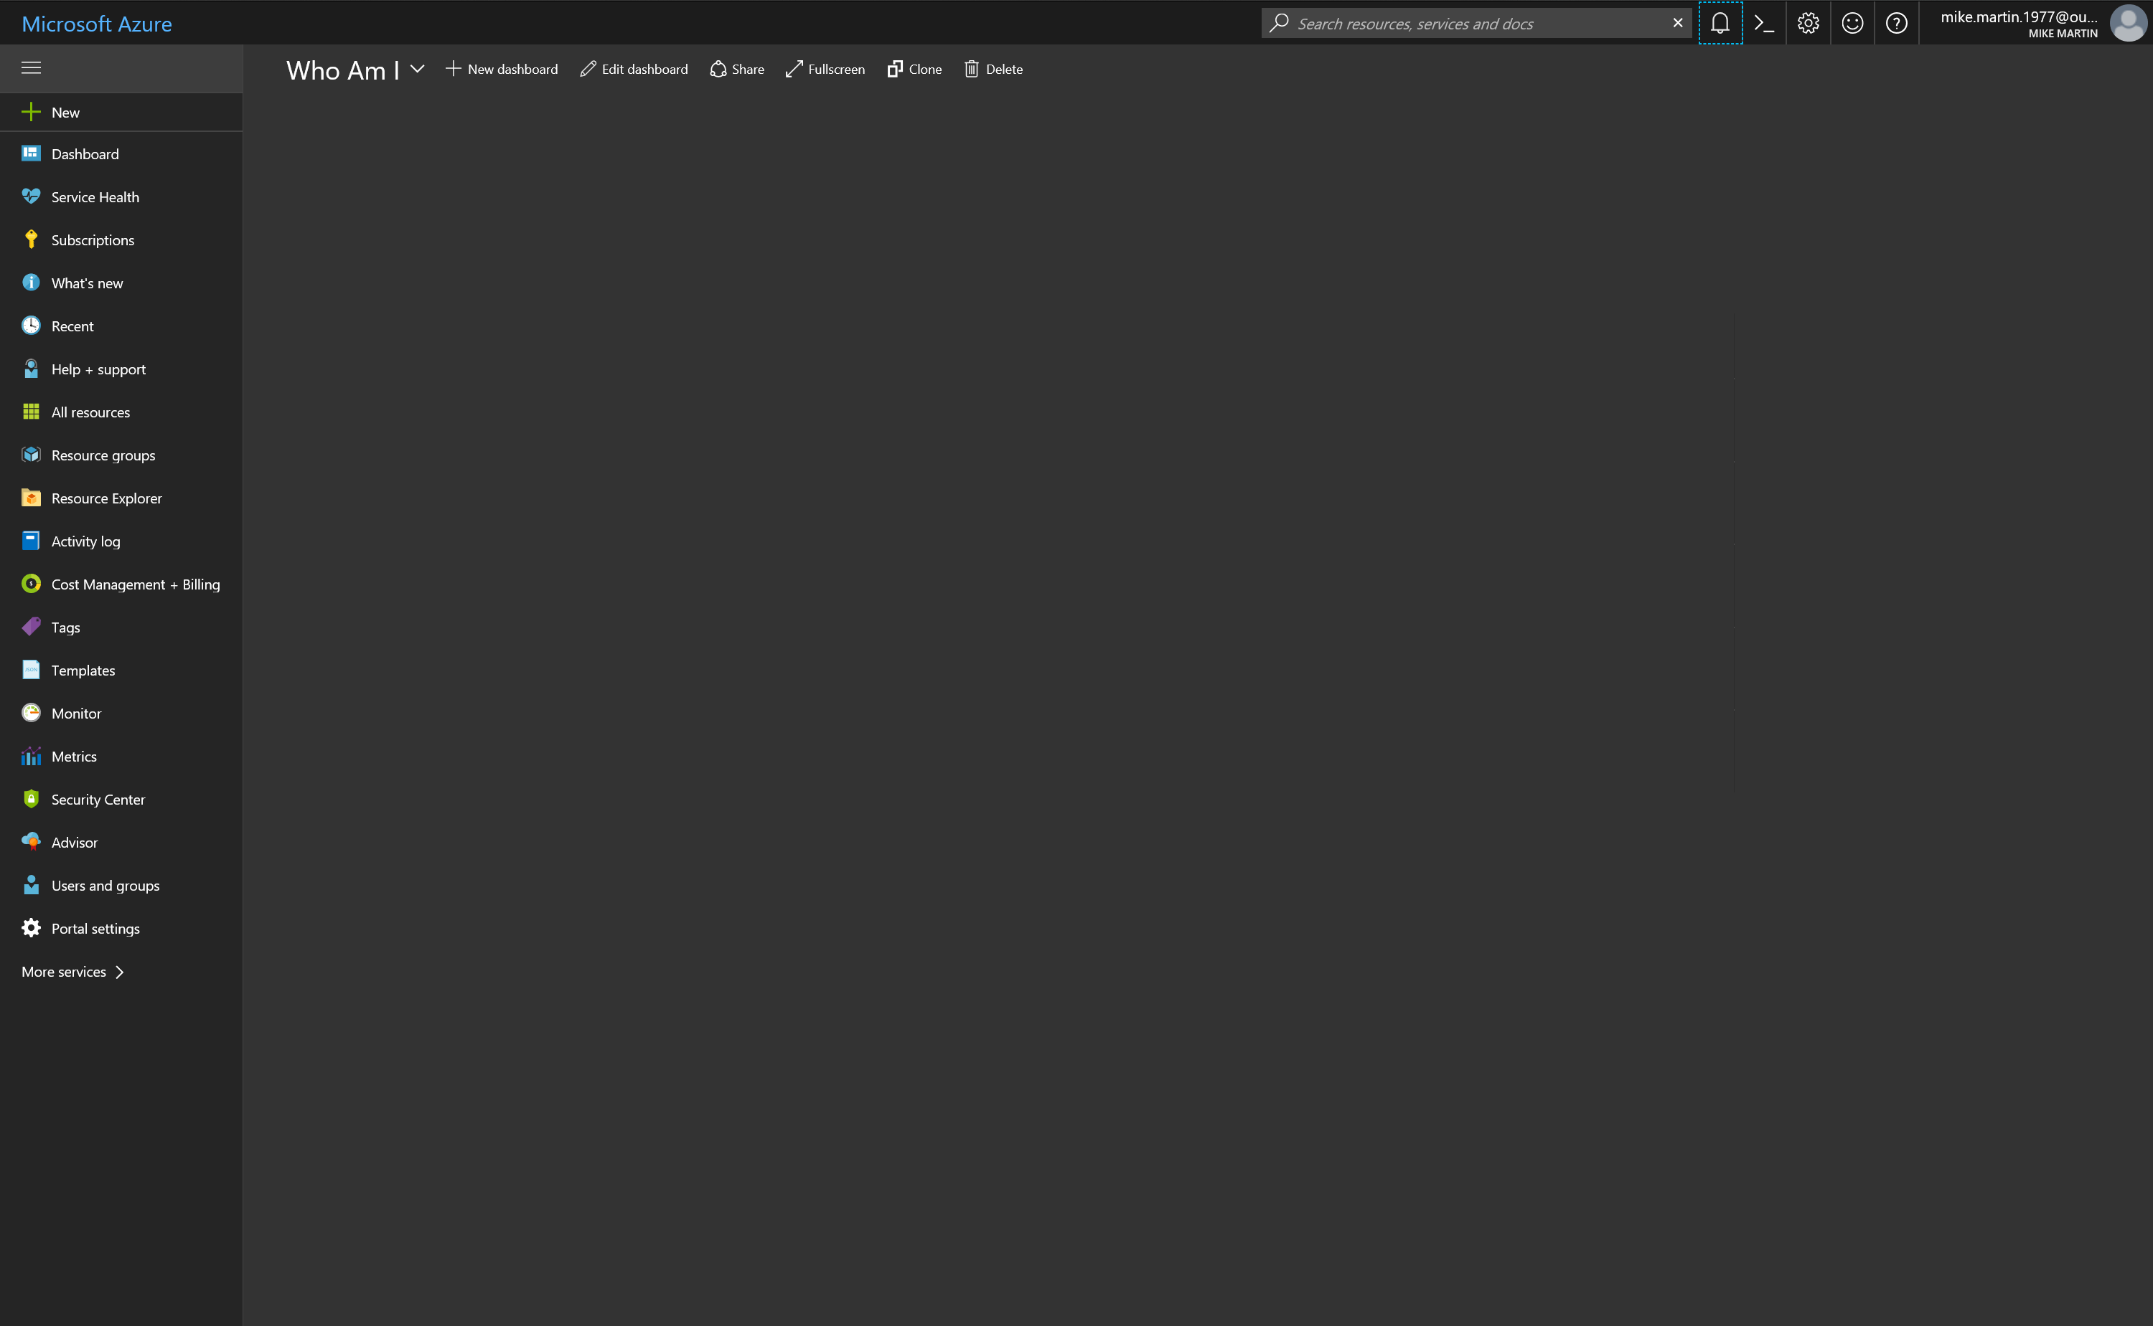

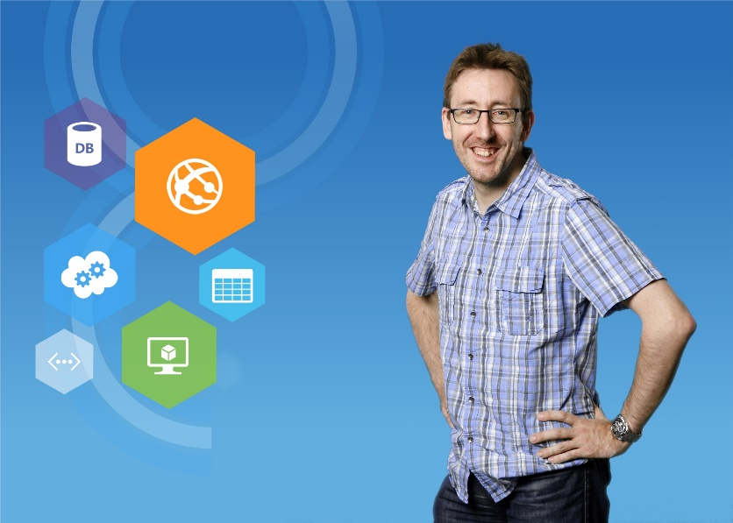
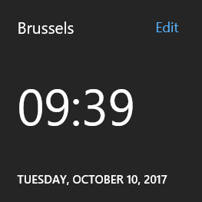
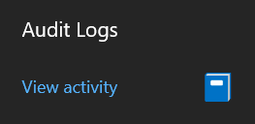

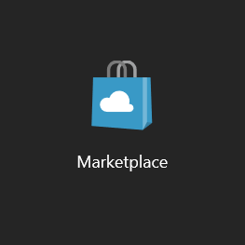
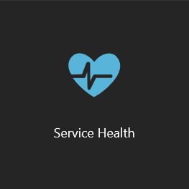
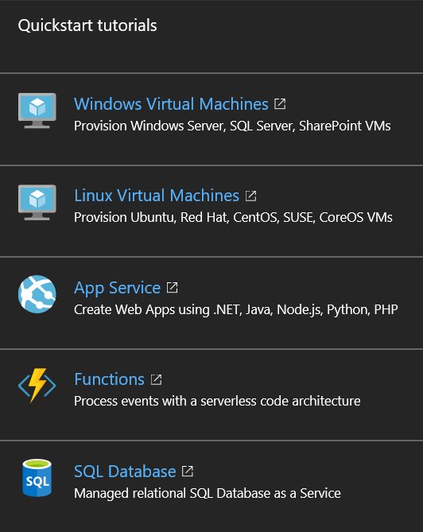



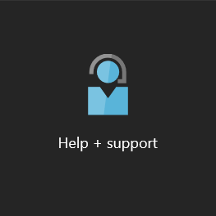

//what
Flexible
Passionate about tech
Family
Global reach
Knowledge sharing
//also
curious
Straightforward
Feedback eager!
18:58
Mike Martin
Technical Evangelist
#Azure
Ex-MVP, Advisor, User group
Social
@techmike2kx
mimar@microsoft.com

Slide 4
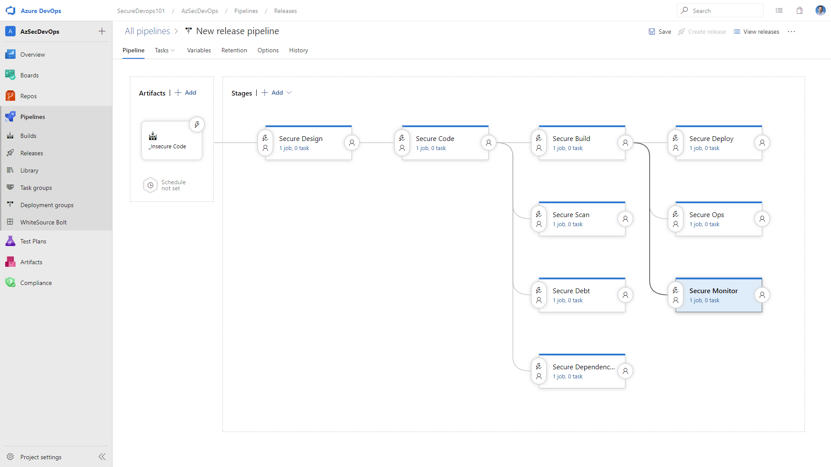
Dev Sec Ops Flow

Slide 5
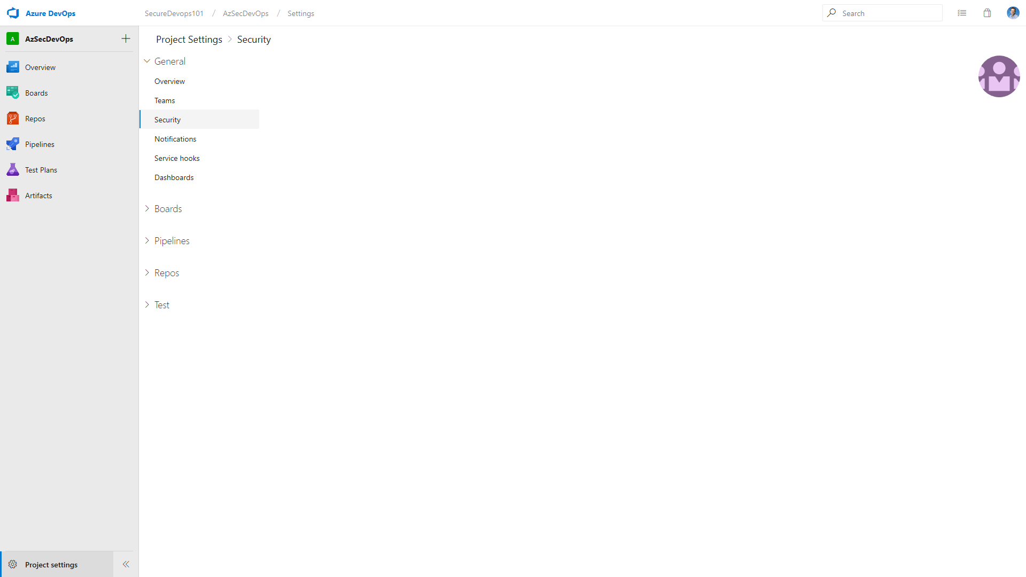
Security Development Lifecycle
Education
Process
Accountability
Administer and track security training
Guide product teams to meet SDL requirements
Establish release criteria & sign-off as part of FSR
Incident
Response (MSRC)
Training
Requirements
Design
Implementation
Verification
Release
Response
Ongoing Process Improvements

Slide 6
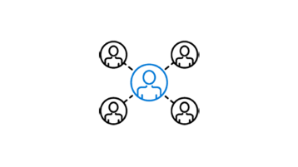
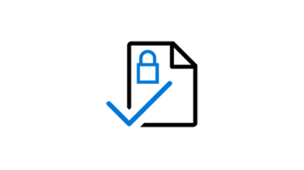
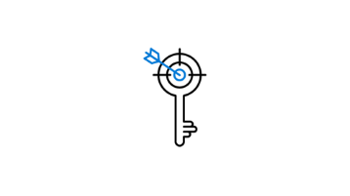
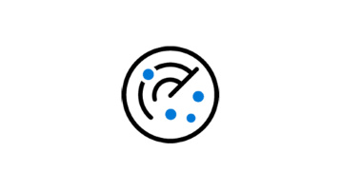
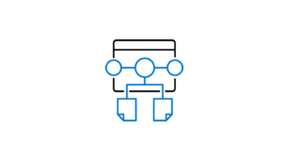
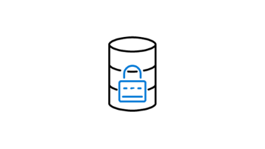
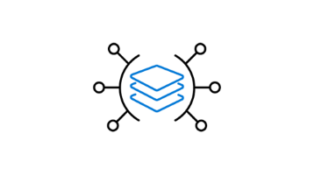
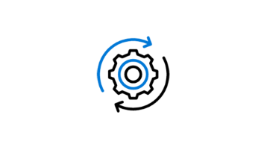
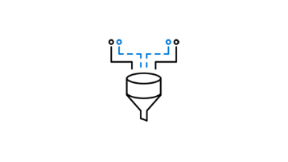
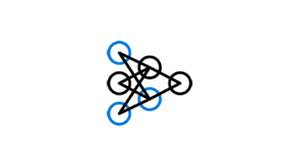

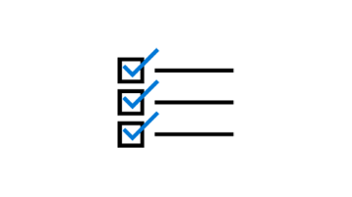
SDL (Best) Practices
Provide Training | Define Security Requirements | Define Metrics and Compliance Reporting | Perform Threat Modeling
Establish Design Requirements | Define and Use Cryptography Standards | Manage the Security Risk of Using Third-Party Components | Use Approved Tools
Perform Static Analysis Security Testing (SAST) | Perform Dynamic Analysis Security Testing (DAST) | Perform Penetration Testing | Establish a Standard Incident Response Process

Slide 7
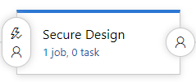

Slide 8
STRIDE
Spoofing
Authentication
Integrity
Repudiation
Non-repudiation
Information disclosure
Tampering
Confidentiality
Denial of Service
Availability
Authorization
Elevation of Privilege

Slide 9
DREAD
Damage potential
The Impact / actual damage
Ease of possibility
Exploitability
The success factor (ease of the attack itself)
Affected users
Reproducibility
How many users
Discoverability
How visible is the attack surface

Slide 10
Threat Modeling Simplified
What are you building?
What can go wrong?
What are you going to do about it?
Did you do an acceptable job at 1-3?
Model
Identify Threats
Mitigate
Validate
From “Threat Modeling for Security”, Shostack 2014 http://www.threatmodelingbook.com/

Slide 11
Know Your Code (from a security perspective)
Identify flow of untrusted and sensitive data in your system
…in the code!
Document all security sensitive code paths in source. Write once. Read many.
Document your security intent and decisions in code.
Create security-focused models/diagrams
Better mental models == better ongoing maintenance
Watch out for dependencies. Keep an eye on rotting legacy components.
“Knowledge is power only if a [person] knows what facts not to bother about.” – R.W. Lynd

Slide 12
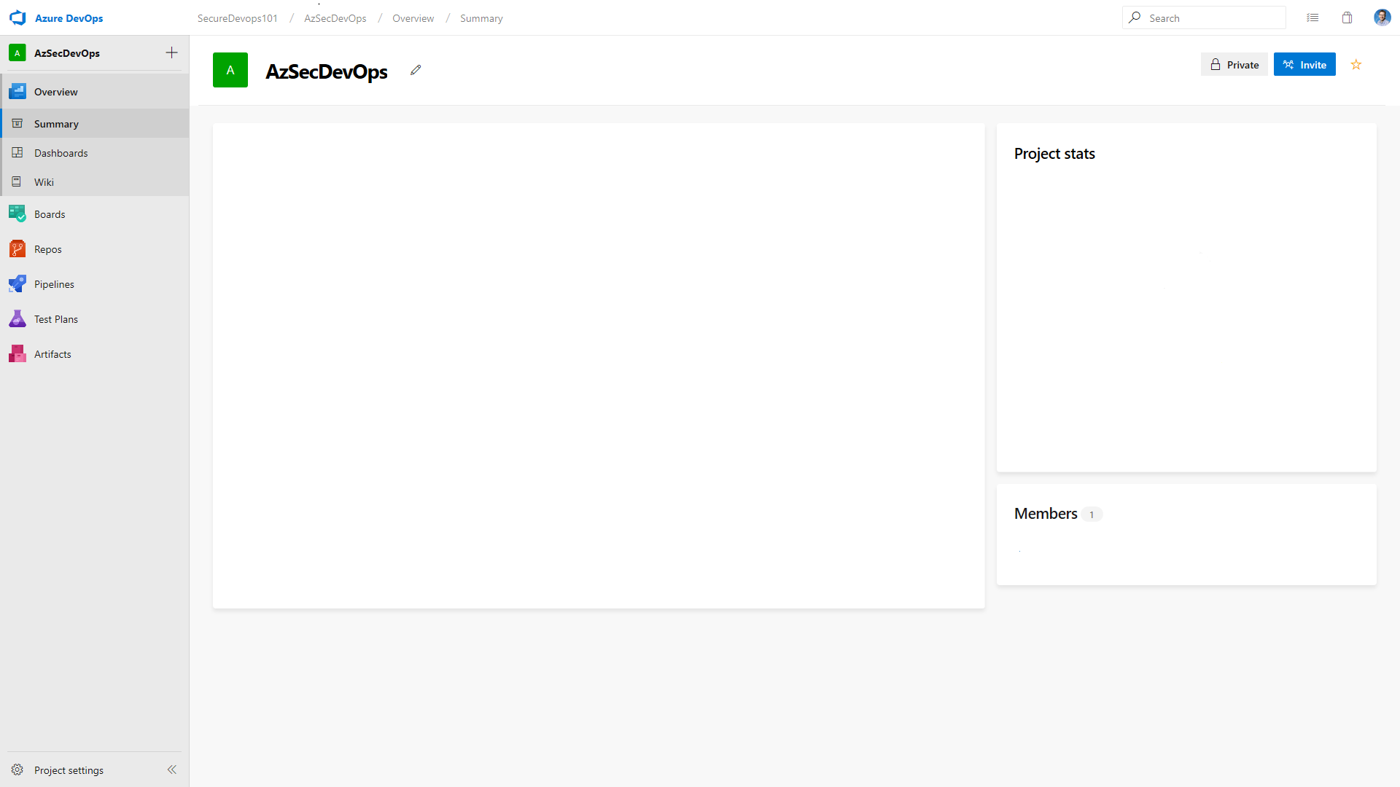
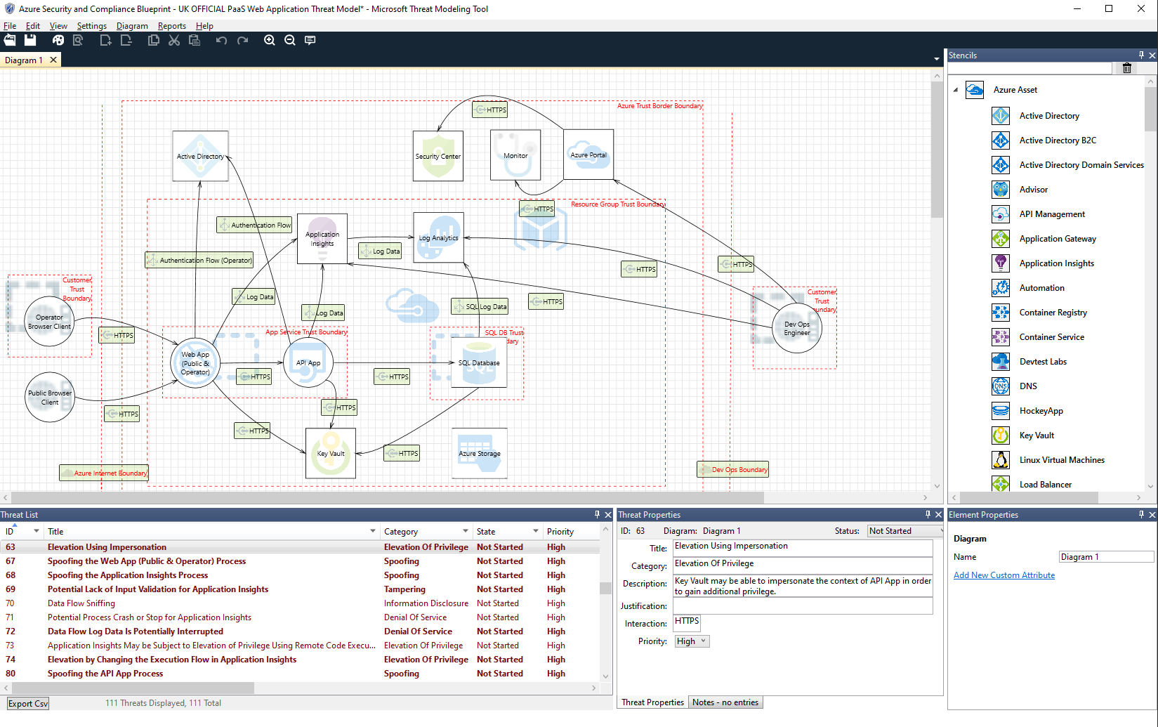
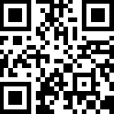
Threat Modeling Tool
http://aka.ms/TMTPreview
Threat Modeling Tool vNext https://blogs.msdn.microsoft.com/secdevblog/2017/04/21/whats-new-with-microsoft-threat-modeling-tool-preview/

Slide 13

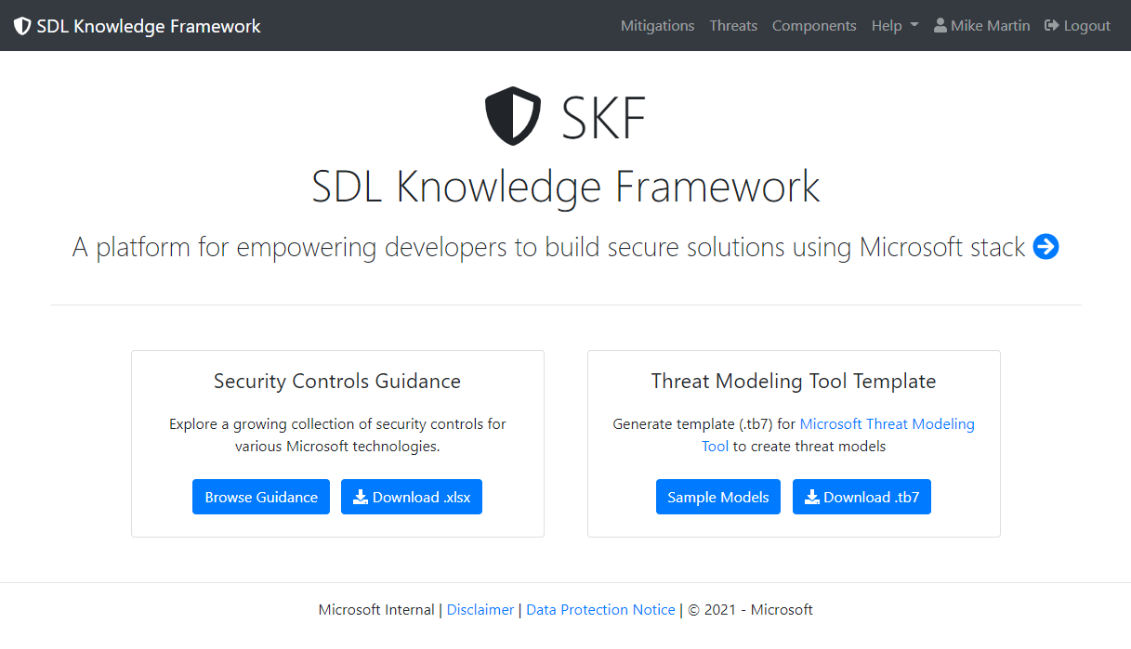
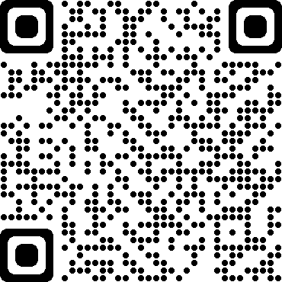
SDL Knowledge Framework
https://aka.ms/skf

Slide 14
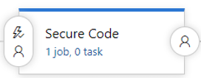

Slide 15
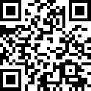
Key Configuration Package
Keyvault Configuration Package
To use the provider, add a reference to the Microsoft.Extensions.Configuration.AzureKeyVault package.
Secret Manager
The Secret Manager tool stores sensitive data for development work outside of your project tree. The Secret Manager tool is a project tool that can be used to store secrets for a .NET Core project during development. With the Secret Manager tool, you can associate app secrets with a specific project and share them across multiple projects.
Add to .csproj following and save to restore the associated NuGet package
<DotNetCliToolReference Include="Microsoft.Extensions.SecretManager.Tools" Version="2.0.0"
/>
https://aka.ms/keyvaultnetcore
ASP.Net Secrets Manager & Keyvault Configurator

Slide 16
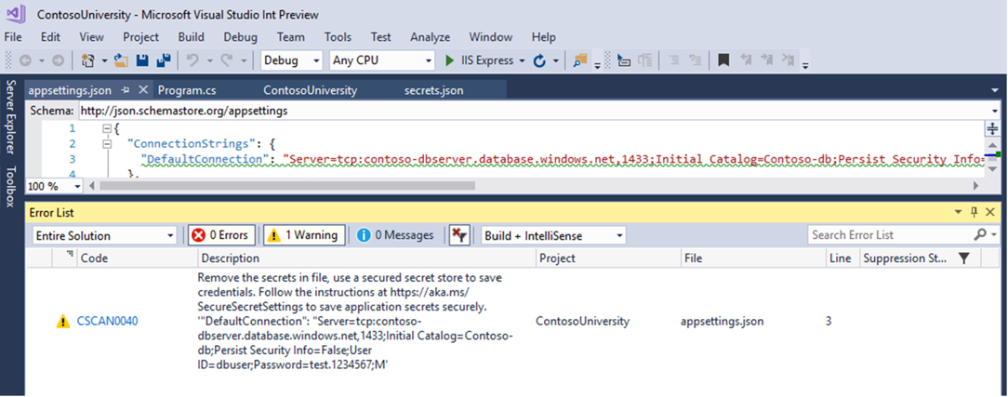
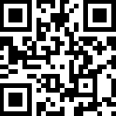
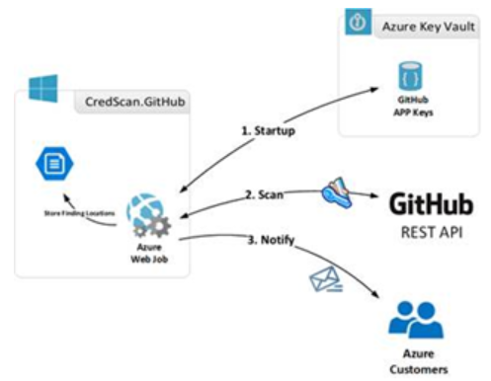
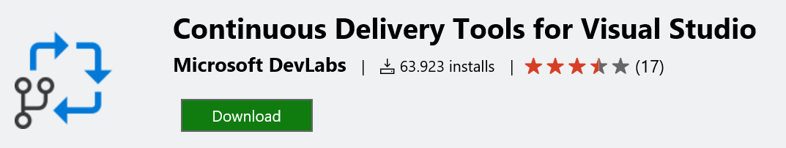
Credscan
Github Advanced Security :
Secret Scanning
https://aka.ms/SecCode

Slide 17
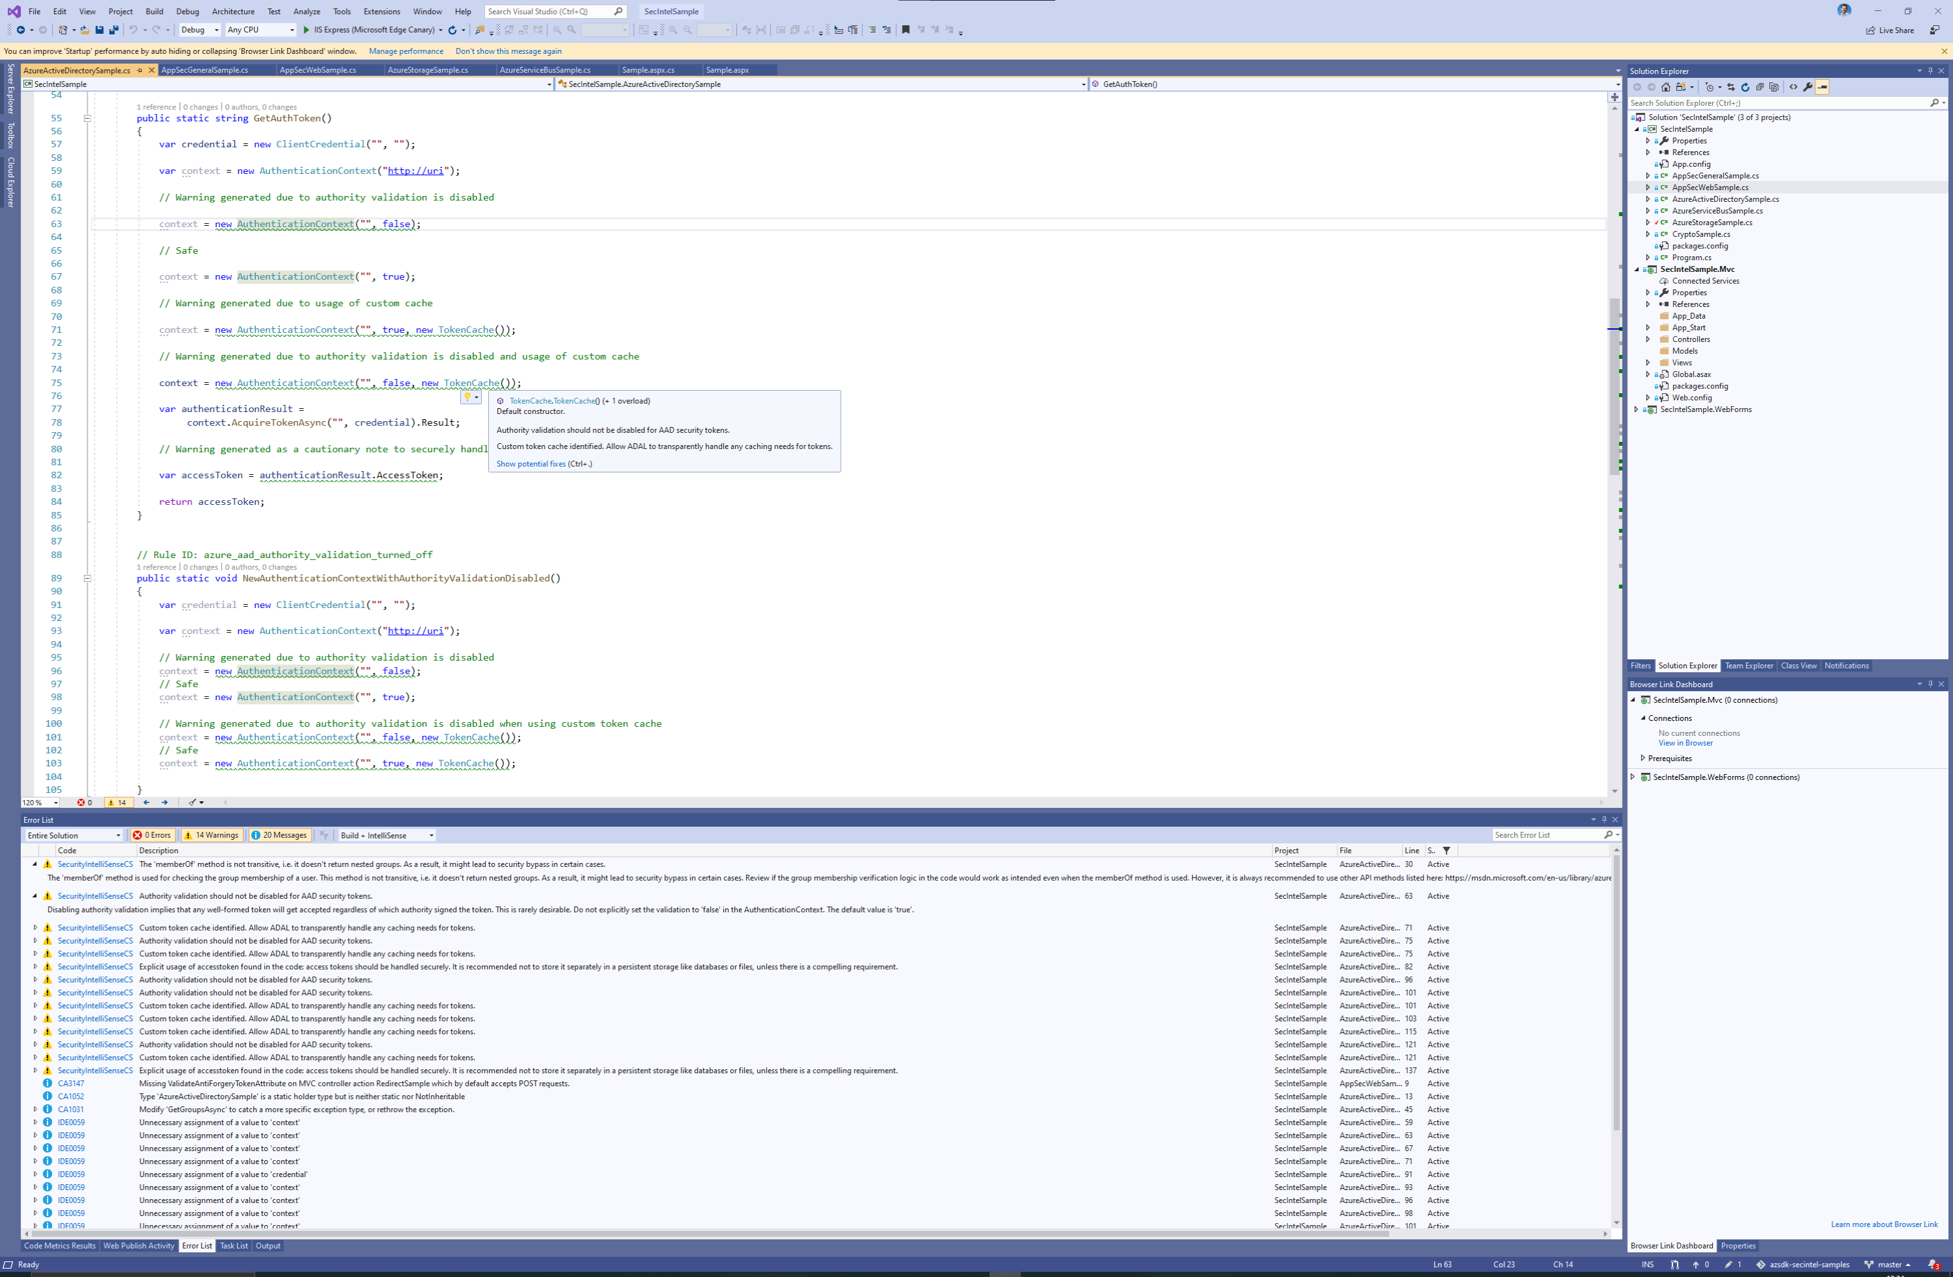
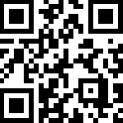
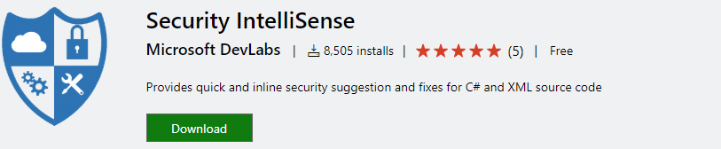
SecIntellisense
https://aka.ms/SecIntel

Slide 18
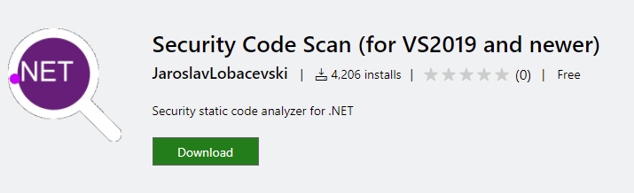
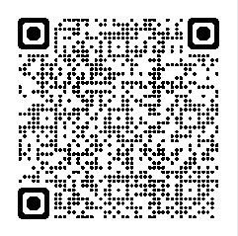
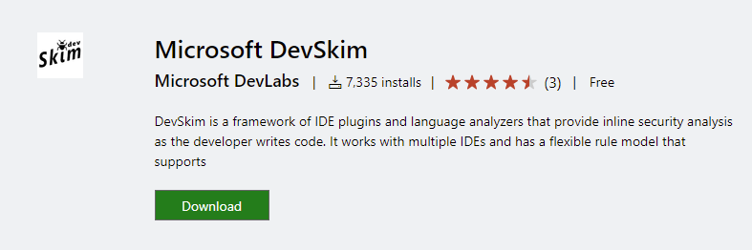
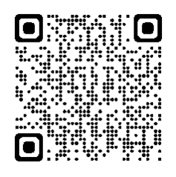
Additional Code Intellisense

Slide 19
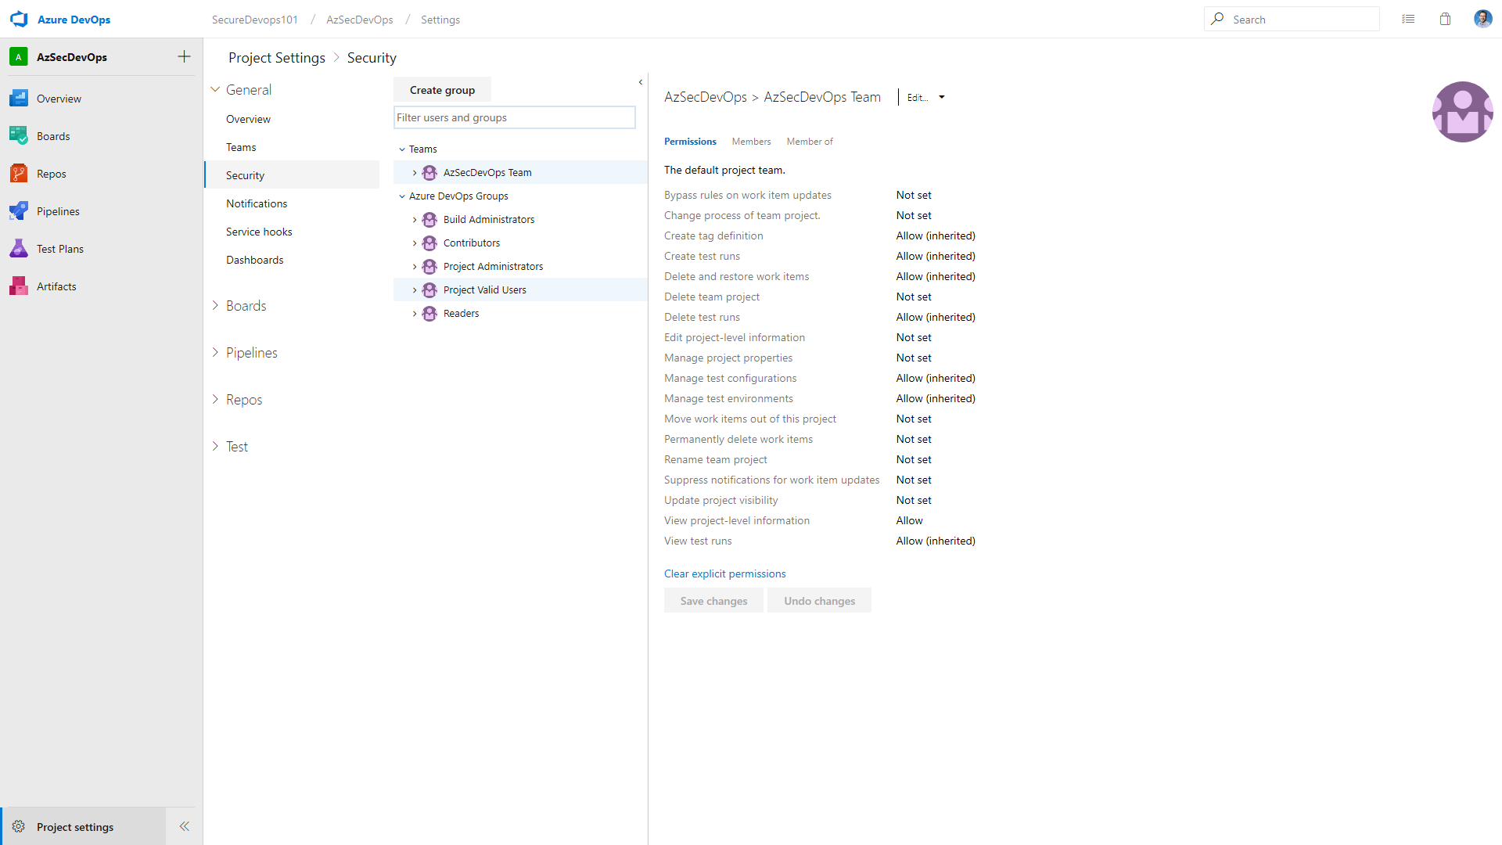

Slide 20
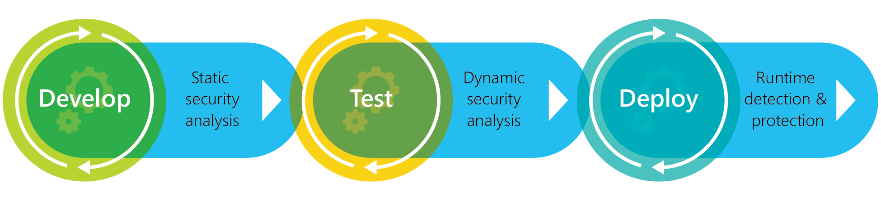
SecOps

Slide 21
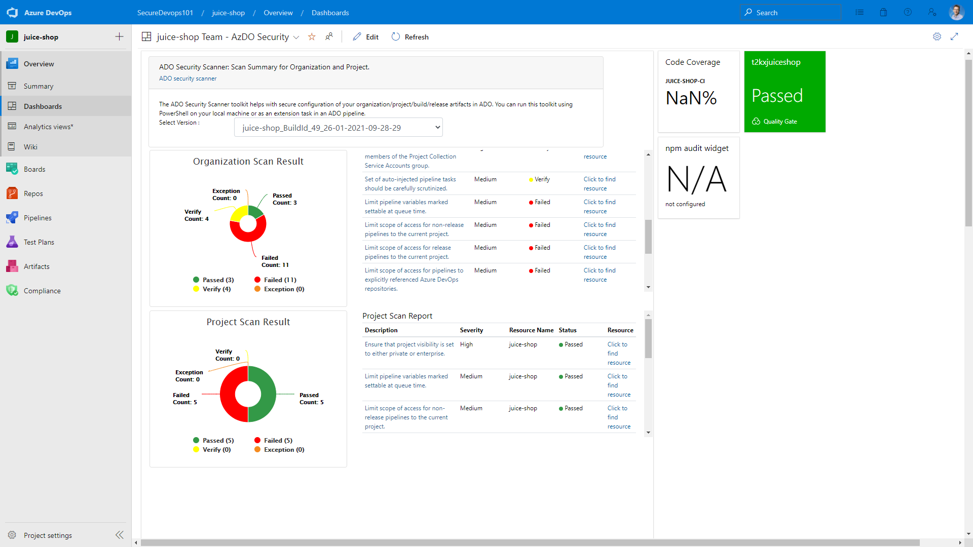
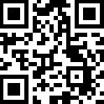
AzSK – ADOScanner
https://aka.ms/adoscanner

Slide 22
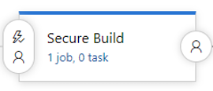

Slide 23
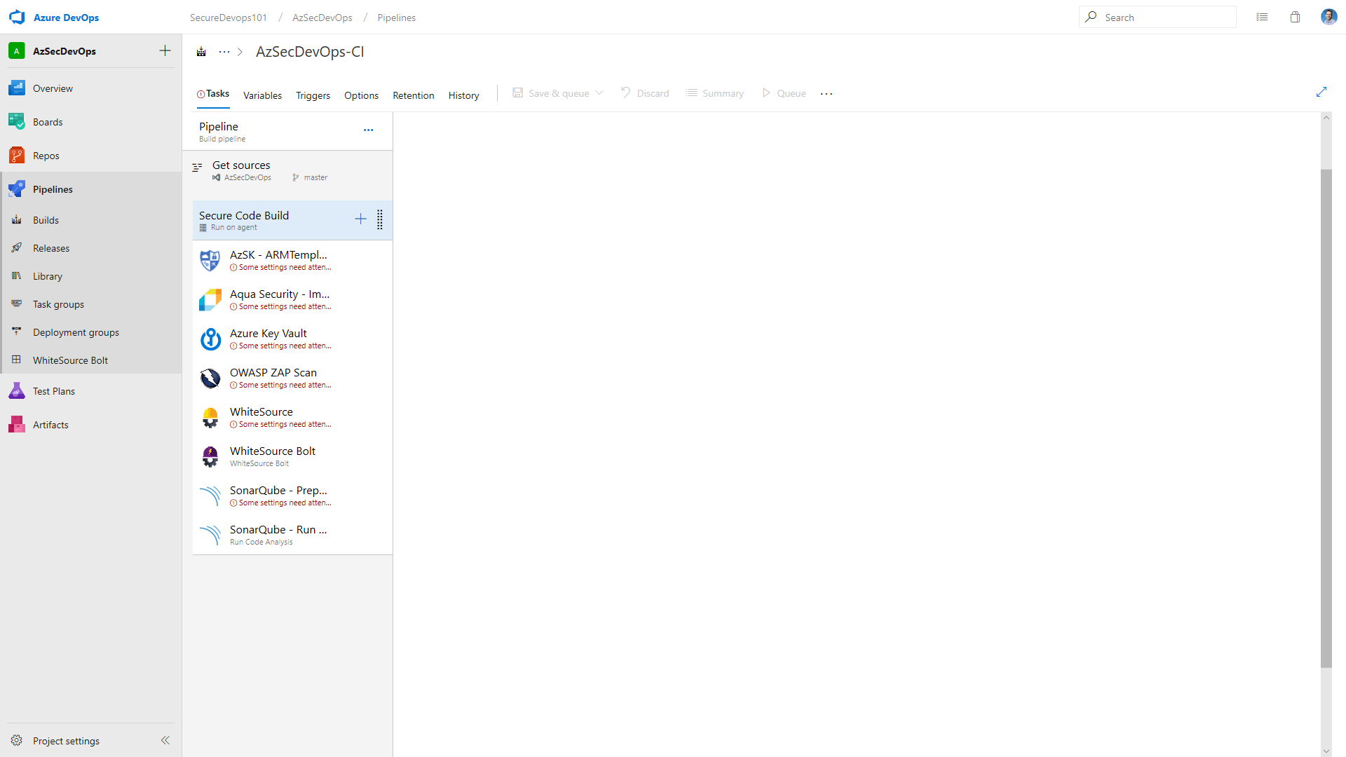
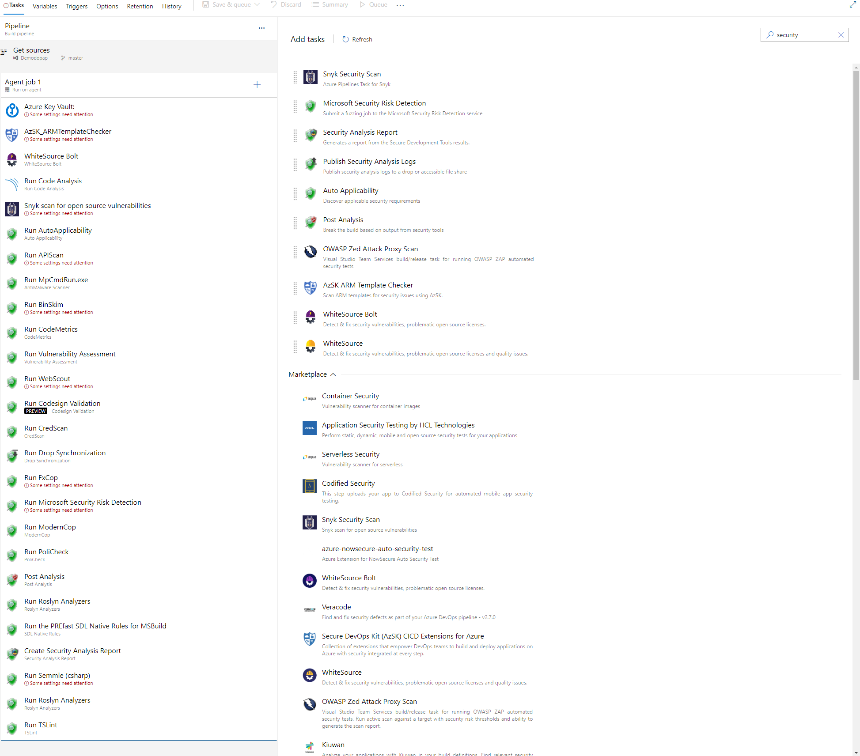

Slide 24
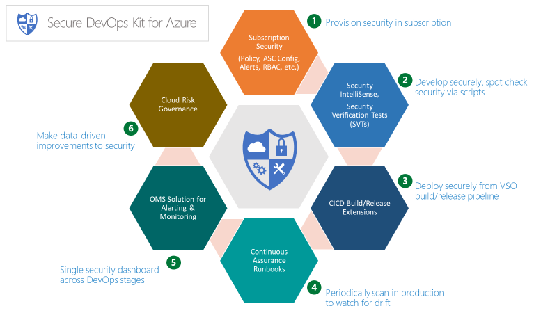
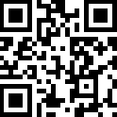

AzSK – Azure Secure Devops Kit
https://aka.ms/azskdevops

Slide 25


Azure Tenant Security Solution (AzTS)
https://aka.ms/azskts

Slide 26



ARM TTK
https://aka.ms/arm-ttk

Slide 27



Aka Project “Springfield”
Microsoft Security Risk Detection
https://aka.ms/secriskdetect

Slide 28
Simple process, compelling results
Runs multiple fuzzers or web attack modules in parallel
Reports issues by severity with full test cases
Start with binaries or URL; no source code required
Only reports bugs
that reproduce
Provides CI/CD integration
You remediate your code
Re-test as part of the CI\CD pipeline

Slide 29





Whitesource + Bolt
https://aka.ms/ADOWS

Slide 30



Snyk.io
https://snyk.io

Slide 31



SonarQube
https://aka.ms/ADOSonar

Slide 32



Security Code Analysis
https://aka.ms/MSCA
https://aka.ms/mscadocs

Slide 33

Azure Code Signing
PREVIEW
TBD
PREVIEW

Slide 34

Github Code Analysis

Slide 35


Slide 36
RBAC best practices
Follow the principle of granting the least privilege required to do the expected work
Inherited to all children of the assigned scope
Use Management Groups to assign roles across multiple subscriptions
Learn and use Managed Identities where possible

Slide 37





Governance
Follow the principle of granting the least privilege required to do the expected work
Inherited to all children of the assigned scope
Use Management Groups to assign roles across multiple subscriptions
Learn and use Managed Identities where possible
Management
Groups
Developers
Cost
Management
Cloud Custodian Team
Operations
Policy
Blueprints
Templates
RBAC
Policies

Slide 38



Azure Blueprints Key Features
Manage Environments
Easy to compose
Secure Resources
Idempotent blueprint definitions efficiently provision and manage infra at scale
Define all your artifacts (policies, RBAC, templates) that go into an environment in a simple experience (both UI and code)
Lock down foundational infra to protect them from unwanted tampering – even owners

Slide 39

Azure Blueprints Key Features
ARM Templates
Policy Definitions
2
Contoso Blueprint
Secure foundational resources
Role-based access controls
Subscription A
Cloud Engineer
Subscription B
1
Custom Scripts*
Create a Blueprint definition and add artifacts
Subscription C
3
…
Stamp out environments
Cloud Architect
Coming in June
Version and Update Blueprints
4
ISO 27001
FedRAMP
+
NIST
…
5
Built-in Blueprints

Slide 40


Slide 41


Azure Security Center
https://aka.ms/ASC
Monitor
Mitigate
Troubleshoot
Forensics
Security doesn’t stop at the endpoint of the Devops Flow …. IT LIVES ON

Slide 42




Azure Security Center
Azure Storage
Availability
Reliability
Azure Container Registry
AKS with RBAC
Active Directory
Azure VNet
SQL Database
Node
Node
Pod
Pod
Encrypted Storage
AAD Pod Identity
Cosmos DB
Azure Key Vault
Full-stack security

Slide 43


Azure Container Registry support in Azure Security Center
Discovery of scanned Azure Container Registry (ACR) registries in a customer subscription within Azure Security Center (ASC)
Vulnerability scanning for all pushed images to ACR registries in a customer subscription
Visibility into security vulnerabilities: description, details and severity classification
Vulnerability scanning
ACR
ASC
Actionable recommendations
Variabilities details with severity classification for scanned images
AKS
Cluster
Cluster
Cluster
Public Preview Q4 CY19

Slide 44



=
+
Securing the software supply-chain
Blocking bad actors as a gate
GitHub
40 million developers
96 million repositories

Slide 45



https://securitylab.github.com/

Slide 46


Secure your use of open source end to end
Securing the usage of open source
Vulnerability Dependency Insights and automated security fixes with Dependabot
Pattern based security analysis
Always on security analysis with GitHub advanced security scanning both open source repositories and enterprise code
Global community for security
Integrated into the National Vulnerability Database, MITRE, and WhiteSource for up-to-date security information

Slide 47

Resources
Secure development documentation on Microsoft Azure
https://aka.ms/AAd86ey
Security Code Analysis
https://aka.ms/AAd8qgc
Tools
https://secdevtools.azurewebsites.net/

Slide 48
Using secrets from Azure Key Vault in a pipeline
https://www.azuredevopslabs.com/labs/vstsextend/azurekeyvault/
Managing technical debt with SonarQube and Azure DevOps
https://www.azuredevopslabs.com/labs/vstsextend/sonarqube/
Managing Open-source security and license with WhiteSource
https://www.azuredevopslabs.com/labs/vstsextend/whitesource/
Driving continuous quality of your code with SonarCloud
https://www.azuredevopslabs.com/labs/vstsextend/sonarcloud/
Labs

Slide 49






DAST Tools
Vulnerability Scanner - Web Application Security | Acunetix
Application Security Software | Veracode
Security Testing as a Service: Fortify on Demand
| Micro Focus (microfocus.com)
HCL AppScan | HCL Software (hcltechsw.com)
Netsparker Web App. Security Solution Features
| Netsparker
Vulnerability Scanning Tools | OWASP
Best Dynamic Application Security Testing (DAST) Software in 2020 | G2
Burp Suite Community Edition - PortSwigger

Slide 50
THAT’S ALL FOLKS!!
THANKS!

